Slide 1
CSE 465 Lecture 8
CNN Architectures

Slide 2
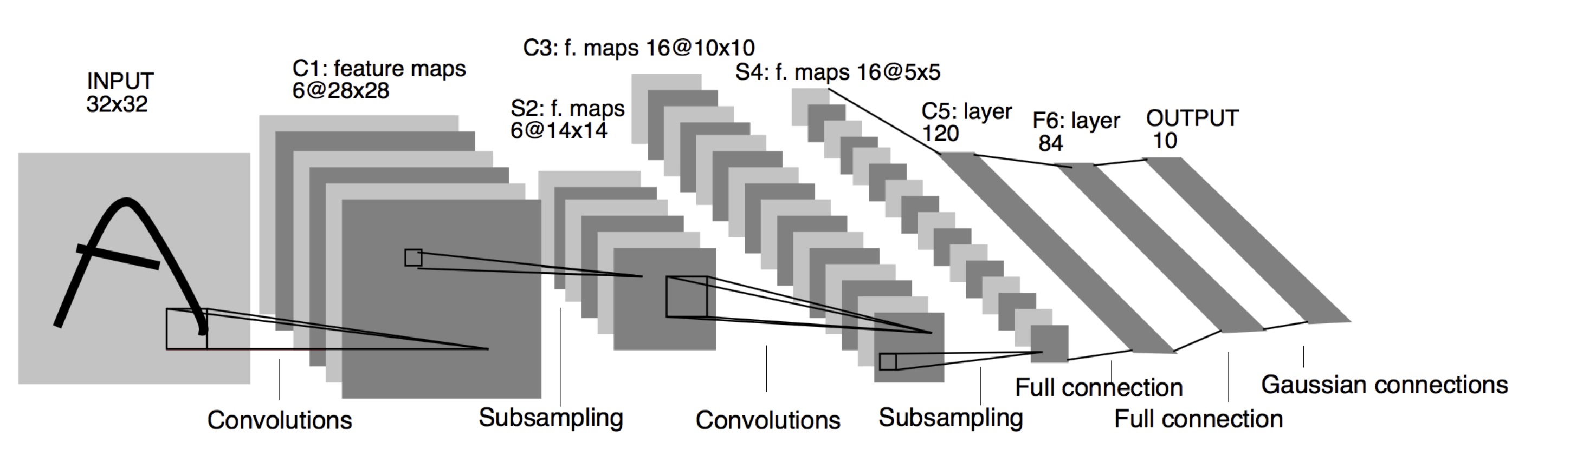
LeNet-5 (1998)

Slide 3
LeNet-5
By modern standards, LeNet-5 is a very simple network
It only has 7 layers
3 convolutional layers (C1, C3, C5)
2 sub-sampling (pooling) layers (S2 and S4)
2 fully connected layer (F6) followed by the output layer
Convolutional layers use 5 by 5 convolutions with stride 1
Sub-sampling layers are 2 by 2 average pooling layers
Tanh activations are used throughout the network

Slide 4
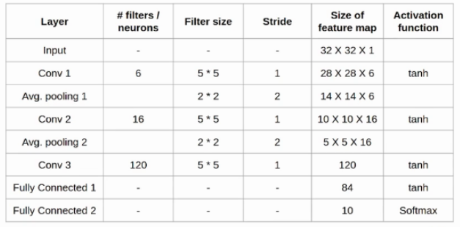
LeNet-5 Architecture Details

Slide 5
LeNet-5
Individual convolutional kernels in the layer C3 do not use all the features produced by the layer S2, which is very unusual by today’s standard
Reason for that is to make the network less computationally demanding
Another reason was to make convolutional kernels learn different patterns. This makes perfect sense: if different kernels receive different inputs, they will learn different patterns
LeNet-5 was able to achieve error rate below 1% on the MNIST data set, which was very close to the state of the art at the time
Around 60K parameters

Slide 6
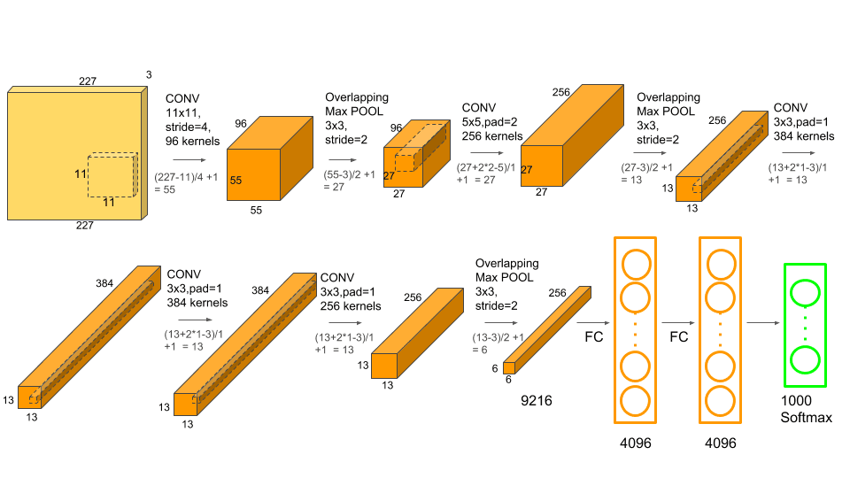






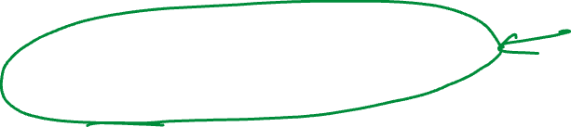

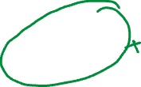
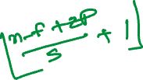














AlexNet
It contains 5 convolutional layers and 3 fully connected layers
The network has 62.3 million parameters, and needs 1.1 billion computation units in a forward pass

Slide 7
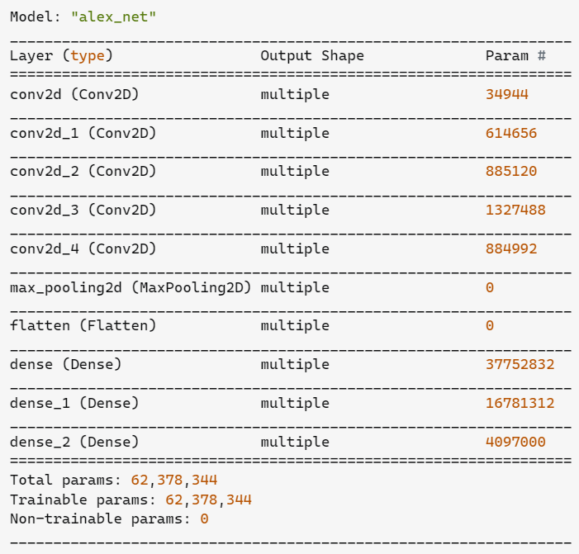
AlexNet Parameter Count

Slide 8


In AlexNet convolution layers accounts for 6% of all the parameters consumes 95% of the computation. The main features of AlexNet are
Copy convolution layers into different GPUs; Distribute the fully connected layers into different GPUs.
Feed one batch of training data into convolution layers for every GPU (Data Parallel).
Feed the results of convolution layers into the distributed fully connected layers batch by batch (Model Parallel) When the last step is done for every GPU. Backpropogate gradients batch by batch and synchronize the weights of the convolution layers.
Obviously, it takes advantage of the features: convolution layers have a few parameters and lots of computation, fully connected layers are just the opposite.

Slide 9
AlexNet Interesting Features
They first used ReLU
Used normalization layers
Heavy data augmentation
Dropout ratio 0.5
Batch size 128
SGD momentum 0.9
Learning rate 1e-2 – reduced manually by 10

Slide 10
AlexNet Conclusion
AlexNet famously won the 2012 ImageNet ILSVRC-2012 competition by a large margin (15.3% VS 26.2% (second place) error rates)
The network takes 90 epochs in five or six days to train on two GTX 580 GPUs
SGD with learning rate 0.01, momentum 0.9 and weight decay 0.0005 was used
Learning rate was divided by 10 once the accuracy plateaus
Bigger network than the LeNet-5
Unlike LeNet-5 they used ReLU
Basically used GPU to improve the performance

Slide 11
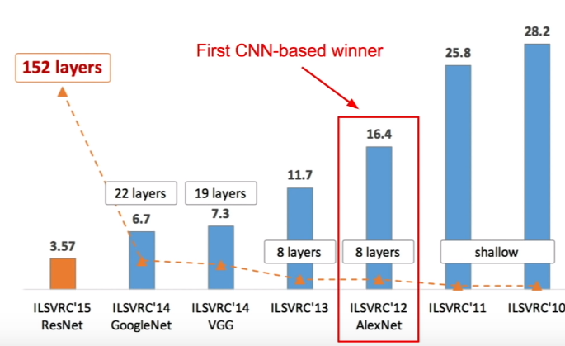
ImageNet Large Scale Visual Recognition Challenge (ILSVRC)

Slide 12
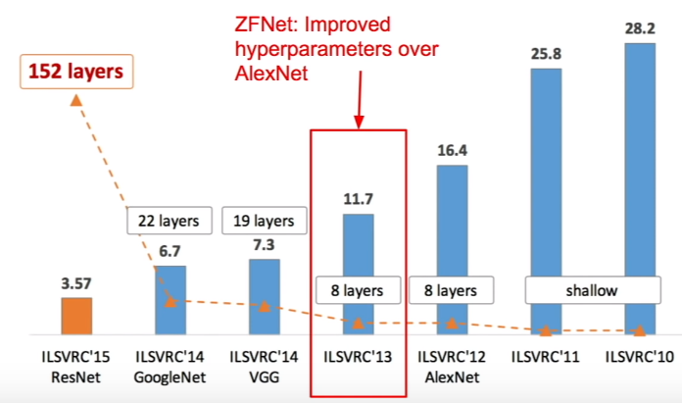
ImageNet Large Scale Visual Recognition Challenge (ILSVRC)

Slide 13
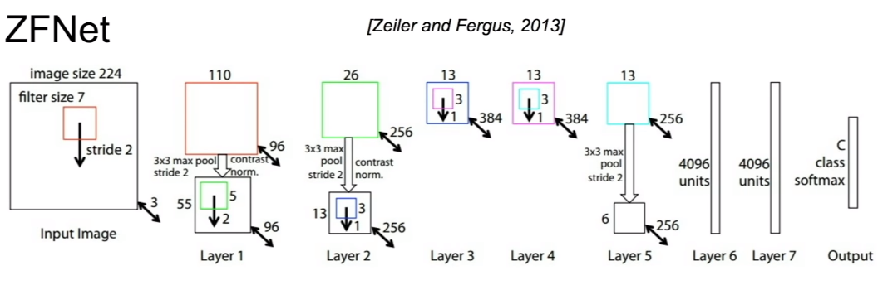
ZFNet
Almost AlexNet – changing hyperparameters
Conv1: Changes from 11X11 stride 4 to 7X7 stride 2
Conv3,4,5: Instead of 384, 384, 256 filters use 512, 1024, 512

Slide 14
VGG-XX
According to the universal approximation theorem, given enough capacity, we know that a feedforward network with a single layer is sufficient to represent any function
However, the layer might be massive, and the network is prone to over-fitting the data
Therefore, there is a common trend in the research community to use small blocks and make the networks deep
Since AlexNet, the state-of-the-art CNN architecture is going deeper and deeper
While AlexNet had only 5 convolution layers, the VGG network has more than 16 layers

Slide 15
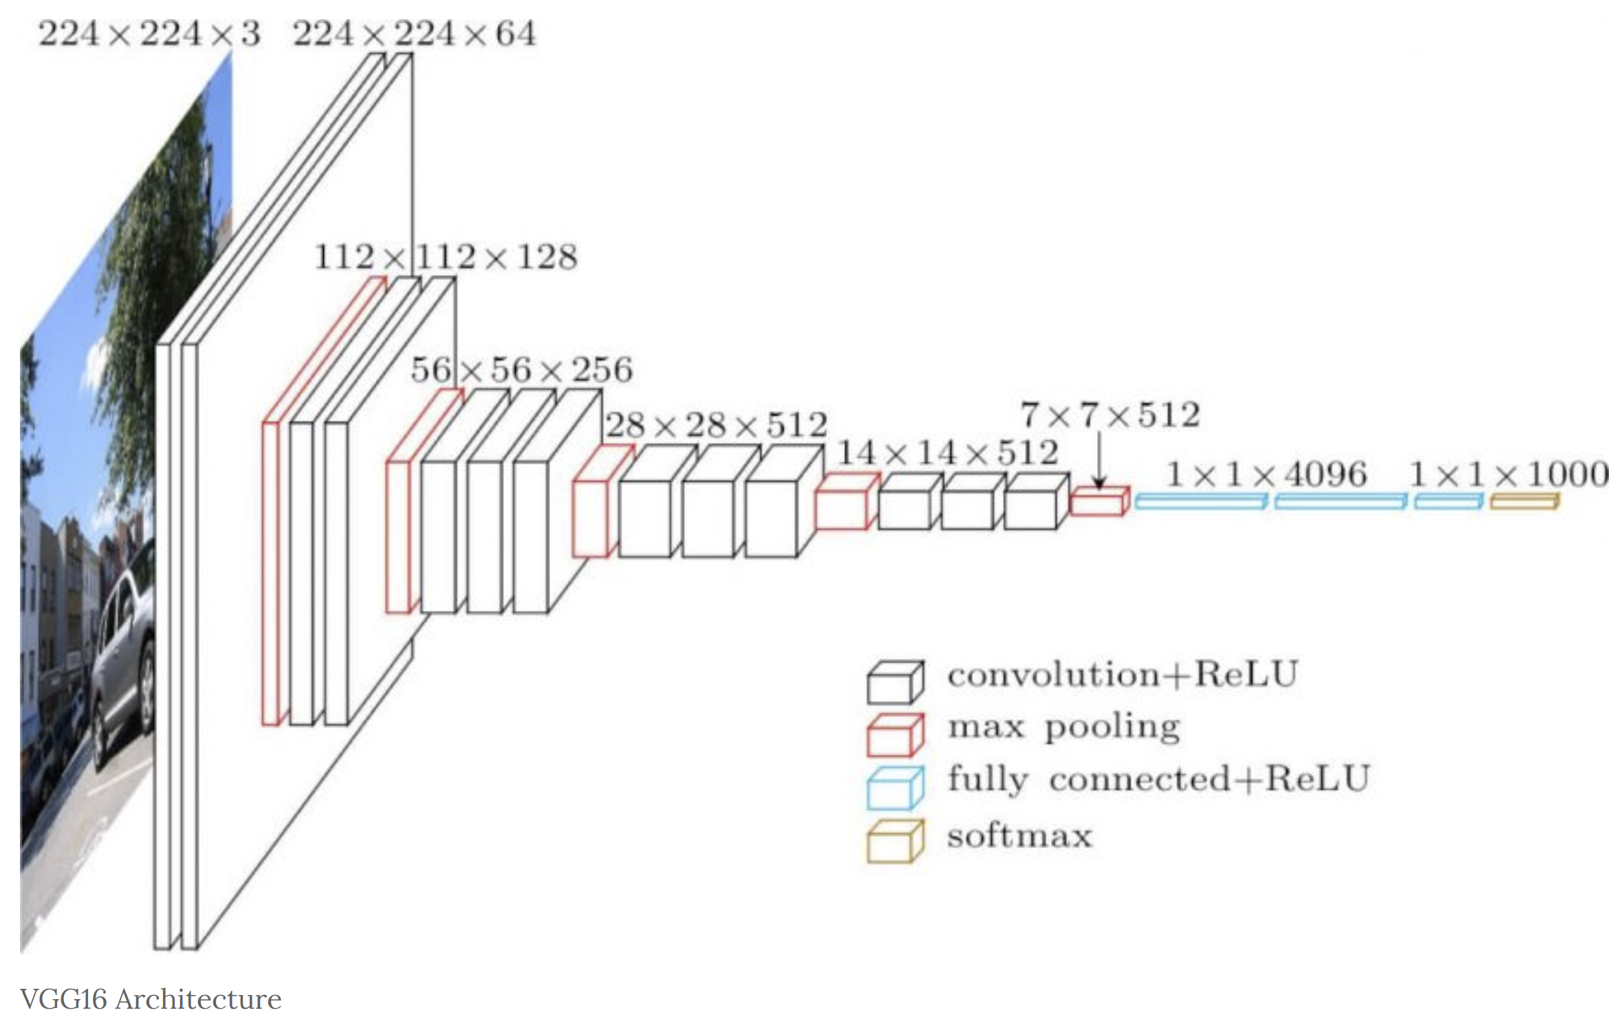
VGG-16

Slide 16
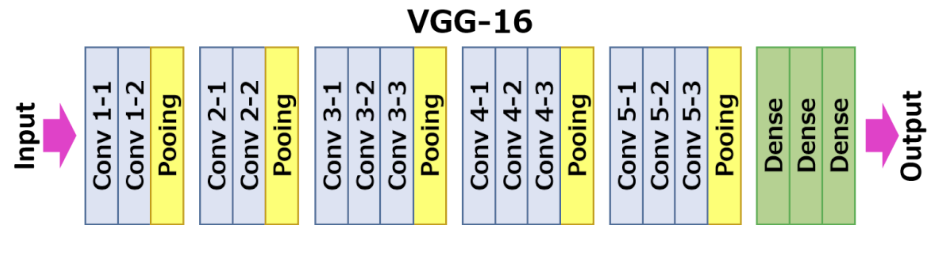
Improvement over AlexNet by replacing large kernel-sized filters (11 and 5 in the first and second convolutional layer, respectively) with multiple 3×3 kernel-sized filters one after another. VGG16 was trained for weeks and was using NVIDIA Titan Black GPU’s.

Slide 17
VGG-16
The input to cov1 layer is of fixed size 224 x 224 RGB image. The image is passed through a stack of convolutional layers, where the filters were used with a very small receptive field: 3×3 (which is the smallest size to capture the notion of left/right, up/down, center).
The convolution stride is fixed to 1 pixel
Padding was used to keep the image size fixed i.e. the padding is 1-pixel for 3×3 convolution layers
Spatial pooling is carried out by five max-pooling layers, which follow some of the conv. layers (not all the conv. layers are followed by max-pooling). Max-pooling is performed over a 2×2 pixel window, with stride 2.

Slide 18
VGG-16
Three Fully-Connected (FC) layers follow a stack of convolutional layers (which has a different depth in different architectures)
The first two have 4096 channels each, the third performs 1000-way ILSVRC classification and thus contains 1000 channels (one for each class)
The final layer is the soft-max layer. The configuration of the fully connected layers is the same in all networks.
All hidden layers are equipped with the rectification (ReLU) non-linearity
It is also noted that none of the networks (except for one) contain Local Response normalization (LRN), such normalization does not improve the performance on the ILSVRC dataset, but leads to increased memory consumption and computation time

Slide 19
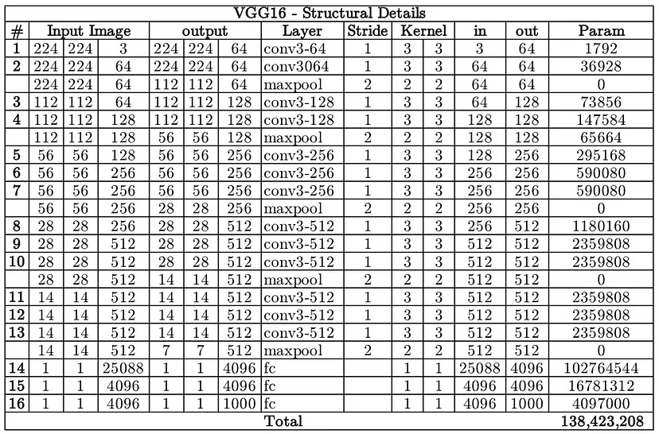
VGG16 Parameter Count

Slide 20
VGG-16
Unfortunately, there are two major drawbacks with VGGNet:
It is painfully slow to train
The network architecture weights themselves are quite large (concerning disk/bandwidth)
Due to its depth and number of fully-connected nodes, VGG16 is over 533MB
There are 138 millions of parameters to learn

Slide 21
VGG improvements over AlexNet
Smaller filters (sometimes called kernels) reduce computations
More parameters
May learn better if we can take care of the overfitting problems
Somewhat modular
Need improvements? Use more blocks
However, increasing network depth does not work by simply stacking layers together
Deep networks are hard to train because of the notorious vanishing gradient problem — as the gradient is back-propagated to earlier layers, repeated multiplication may make the gradient infinitively small
As a result, as the network goes deeper, its performance gets saturated or even starts degrading rapidly

Slide 23
Observations until now
Choosing the right kernel size for convolution is always a big deal in CNNs
The same object can come in various sizes in different images
To capture the features of different sizes, we, of course, need to have kernel sizes accordingly
Bigger kernels are generally good when the object covers most of the area
Smaller kernels are suitable for relatively small objects
The deeper the network, the better it is! But stacking a lot of layers makes the gradient flow difficult and leads to overfitting
In short, the depth of a network is somewhat restricted to a certain limit – beyond this limit, the network is not trainable anymore; it just overfits

Slide 24
Observation until now
Some parts of the image can have extremely large variation in size
For instance, an image of a dog can be big, small, etc.
Even the same image can have dogs of different sizes
Because of this variation in the location/proportion of the information, choosing the right kernel size for the convolution operation becomes tough
A larger kernel is preferred for information that is covering a large part of the image
A smaller kernel is preferred for information that is covering smaller portion of an image
And Inception is born

Slide 25
Observation until now
Very deep networks are prone to overfitting
It also hard to pass gradient updates through the entire network
Naively stacking large convolution operations is computationally expensive
And here comes Resnet

Slide 27
Inception networks
The idea is to use different sizes for convolution kernels in parallel rather than using a single kernel size in a layer
This way, the network now has option to choose kernels having different sizes and the network can now learn features through the kernel that's best suited to the job
Arranging kernels parallel to each other also makes the architecture sparse, which helps to ease the training for deeper networks
The typical InceptionNet uses three convolution kernels of sizes 1 x 1, 3 x 3, and 5 x 5 simultaneously
The results from all these three kernels are concatenated to form a single output vector, which acts as the input for the next layer
The inception layer also adds 1 x 1 convolutions before the 3 x 3 and 5 x 5 kernels in order to reduce the size

Slide 28
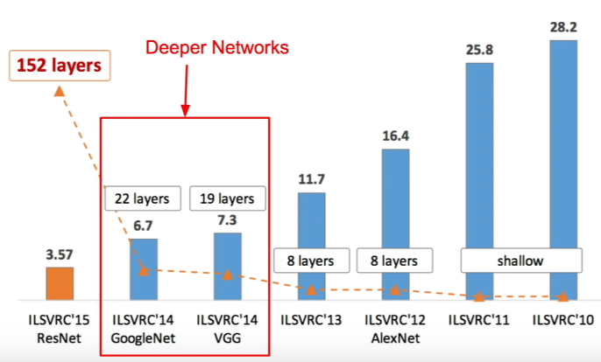


ImageNet Large Scale Visual Recognition Challenge (ILSVRC)

Slide 29
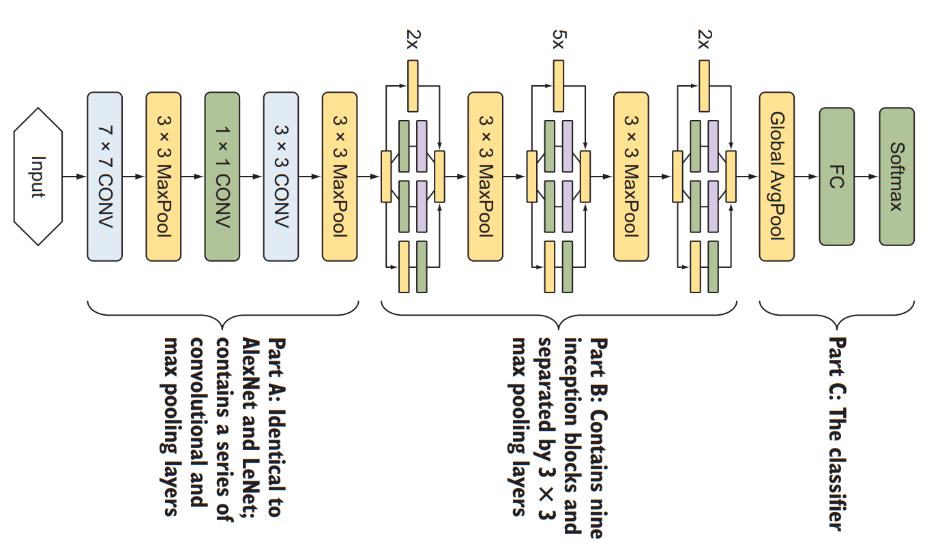

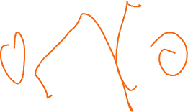


GoogleNet: The complete architecture

Slide 30
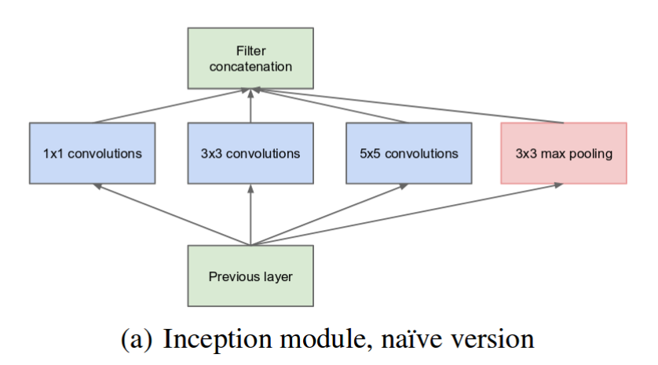
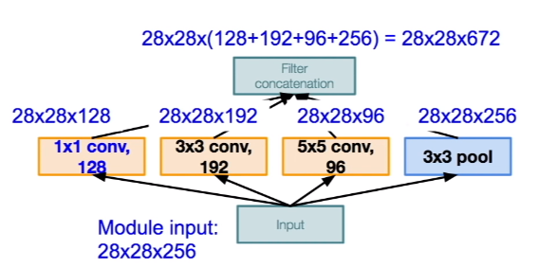


Inception Network (GoogleNet)

Slide 31
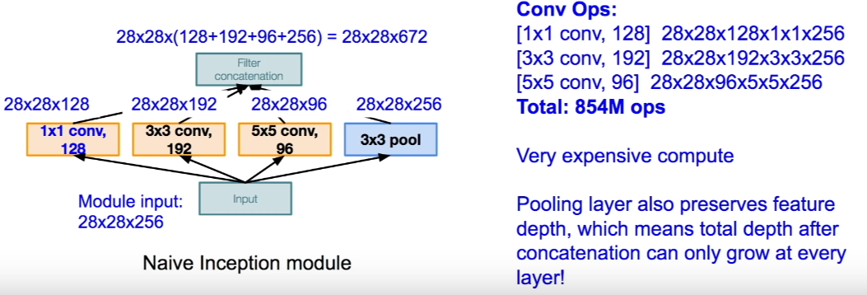


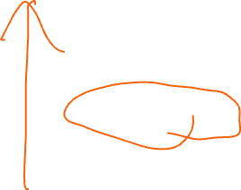

But: The computational complexity

Slide 32
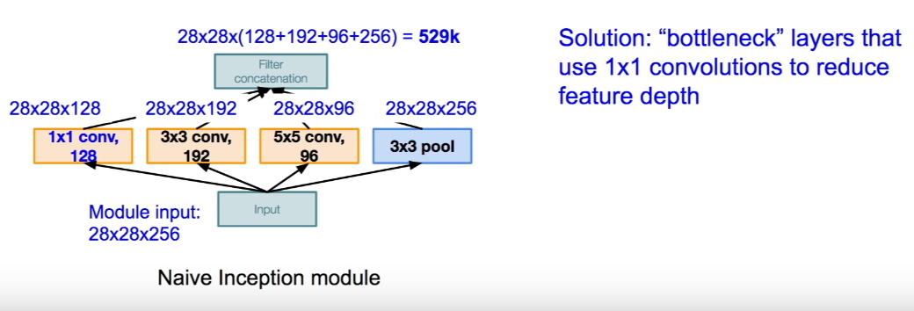
What can be done?

Slide 33
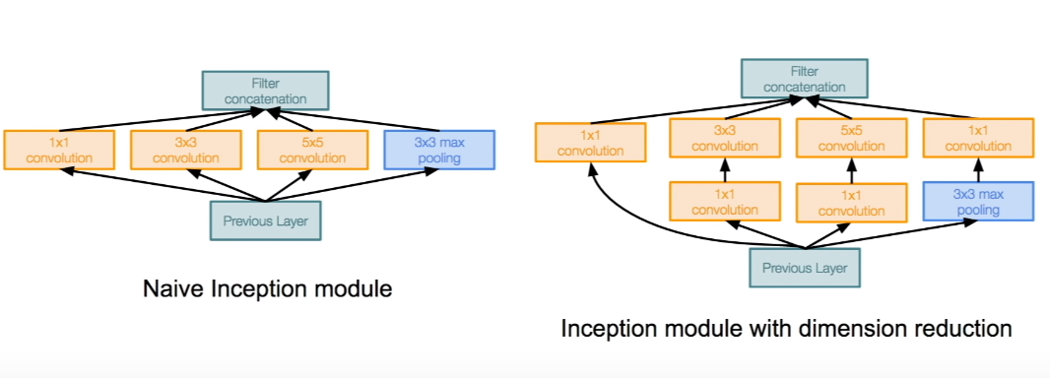
Computationally efficient inception modules

Slide 34
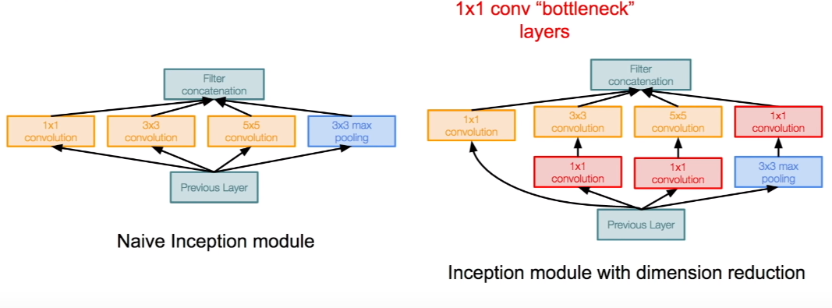
Computationally efficient inception modules

Slide 35
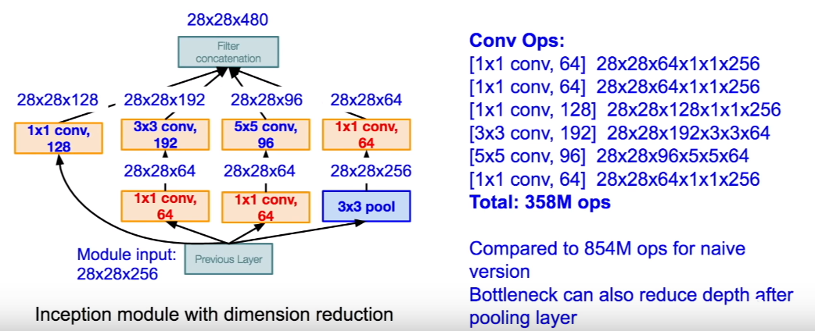





Computationally efficient inception modules The improvements

Slide 36
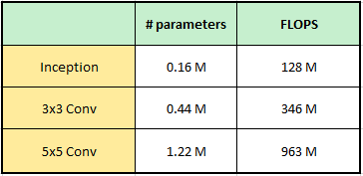

Inception Blocks
The Inception blocks need fewer parameters and less computational complexity than single 3x3 or 5x5 convolutional blocks (in case these were used).
For a 256 channels output layer, Inception needs only 16,000 parameters and costs only 128 Mega FLOPS
A 3x3 convolutional layer would need 44,000 parameters and cost 346 Mega FLOPS
A 5x5 convolutional layer would need 1,22,000 parameters and cost 963 Mega FLOPS
Inception blocks, essentially get the same job done as single convolutional layers, with much better memory and compute efficiency.

Slide 37
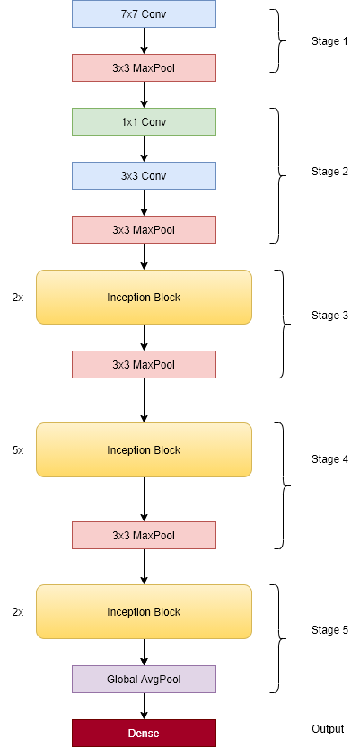




GoogleNet: The complete architecture

Slide 38
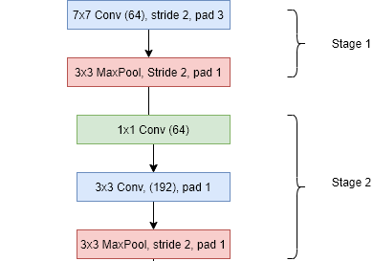




Stage 1 & 2
The network starts with an image size of 224x224x3. Then it goes through a 7x7 Conv, 3x3 MaxPool, 1x1 Conv, 3x3 Conv, and a 3x3 MaxPool, and results in an image of size 192x28x28.
This part of the network is very similar to AlexNet, except that the image size in AlexNet is further reduced to 256x12x12.

Slide 39
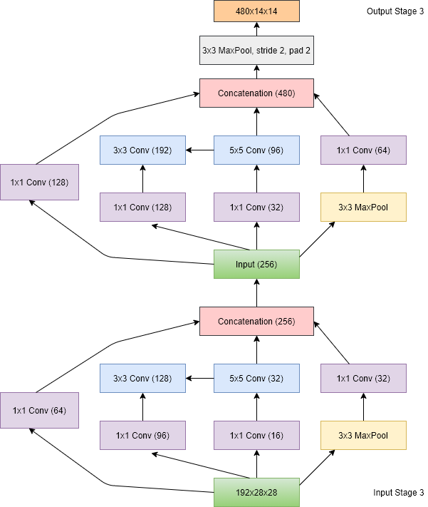



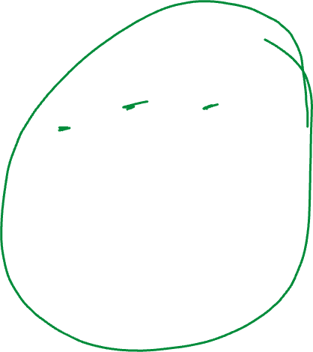

Stage 3
Stage 3 has two Inception blocks and in the end a Max Pool layer.
Block 1 has 256 channels, whereas block 2 has 480 channels.
The input image of 192x28x28 now becomes 480x14x14, after the two inception blocks and the MaxPooling layer.

Slide 40
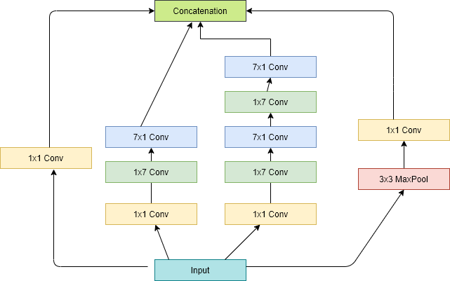


Stage 4
Stage 4 has 5 inception blocks followed by a MaxPool, and stage 5 has 2 inception blocks followed by a GlobalAveragePool
Input image size — 480x14x14
Inception Block 1–512 channels (increased output channel)
Inception Block 2–512 channels
Inception Block 3–512 channels
Inception Block 4–512 channels
Inception Block 5–832 channels (increased output channel)
Output image size after Max Pool — 832x7x7

Slide 41
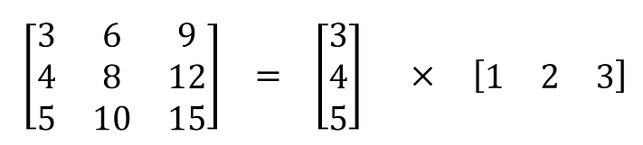
Spatially Separable Convolutions
An NxN 2-D convolution can be decomposed into two 1-D convolution — 1xN and Nx1.
Applying these 1x1 filters sequentially can give same receptive field as original NxN filter.
But, needs much fewer operations and weights
For N=5, it needs 5+5=10 weights instead of 5x5=25 weights.

Slide 42
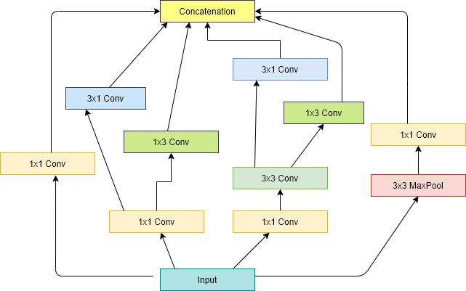

Stage 5
Input image size — 832x7x7
Inception Block 1–832 channels
Inception Block 2–1024 channels (increased output channel)
Output image size after GlobalAvgPool — 1024x1x1

Slide 43



Inception v2,v3,v4
Later GoogleNet has been further improved in different versions v2, v3, and v4.
Inception V2
Add batch normalization
Inception V3
Modified inception block
Replace 5x5 with multiple 3x3 convolutions
Replace 5x5 with 1x7 and 7x1 convolutions
Replace 3x3 with 1x3 and 3x1 convolutions
Have deeper stacks
Inception V4
Add residual connections.

Slide 44
ResNet
ResNet solves a problem that has been restricting the training of very deep networks
During the training of deep networks, the accuracy saturates to a certain limit and then degrades rapidly
This phenomenon has been restricting the accuracy to a certain threshold, no matter how deep the architecture goes
ResNet was introduced by Microsoft research in a paper called, Deep Residual Learning for Image Recognition
This is the first network architecture that has successfully trained a network with a depth of more than 100 layers
What made this impossible possible?
Better weight initializations
New normalization layers
The skip-connections

Slide 45
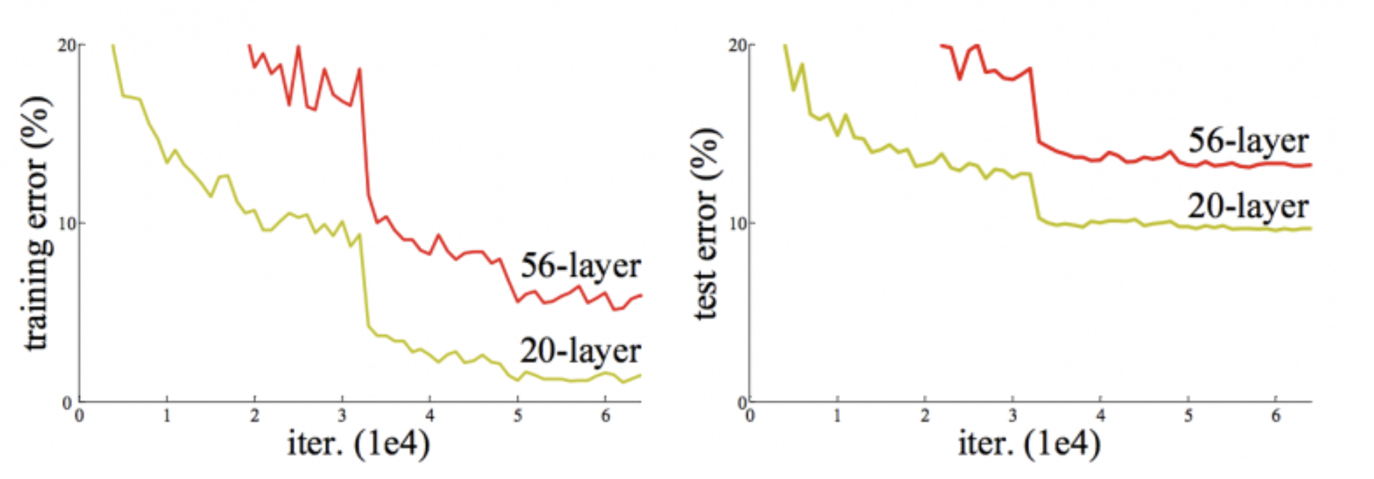
Why ResNet? 56/20 Layers
A group at Microsoft research were going deeper and deeper and found the following graph
Training & test error are lower (better) for a 20 layer network than a 56 layer network!!!
Overfitting is the problem
There was no good way to optimize the weights

Slide 46
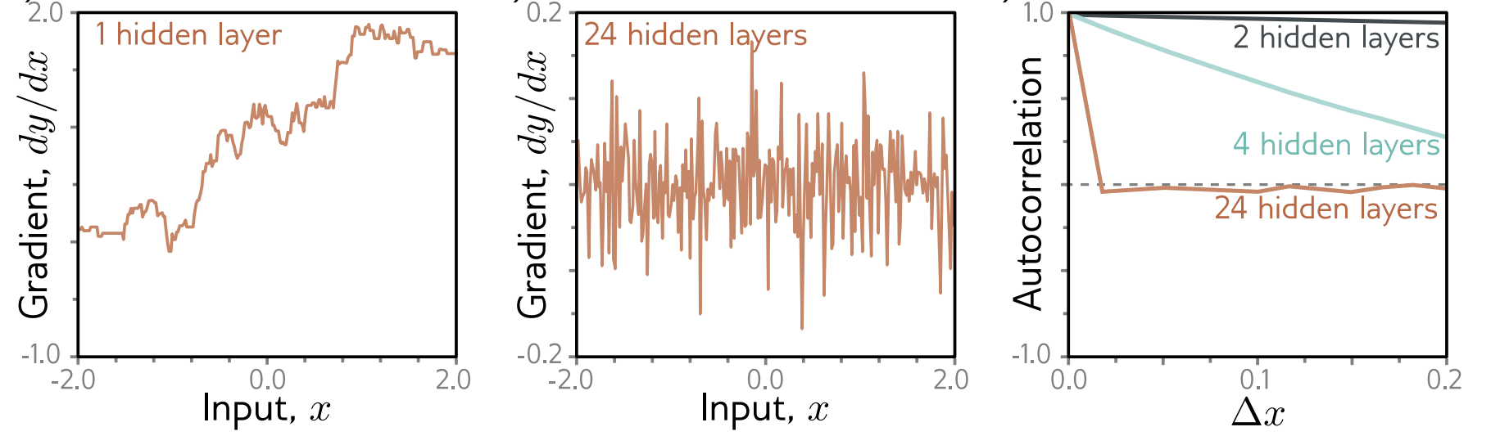
Finding the cause: shattered gradient

Slide 47
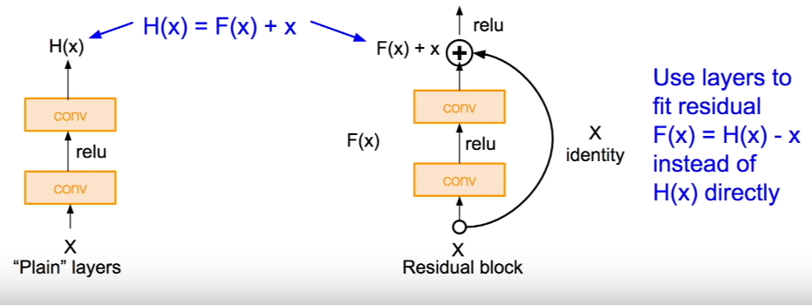
ResNet Concepts
Each layer computes an additive change to the current representation instead of transforming it directly
This allows deeper networks to be trained but causes an exponential increase in the activation magnitudes at initialization
Residual blocks use batch normalization to compensate for this, which re-centers and rescales the activations at each layer
This kind of creates a connection from the input to the output of the layer, which is called the residual connection or skip connection

Slide 48
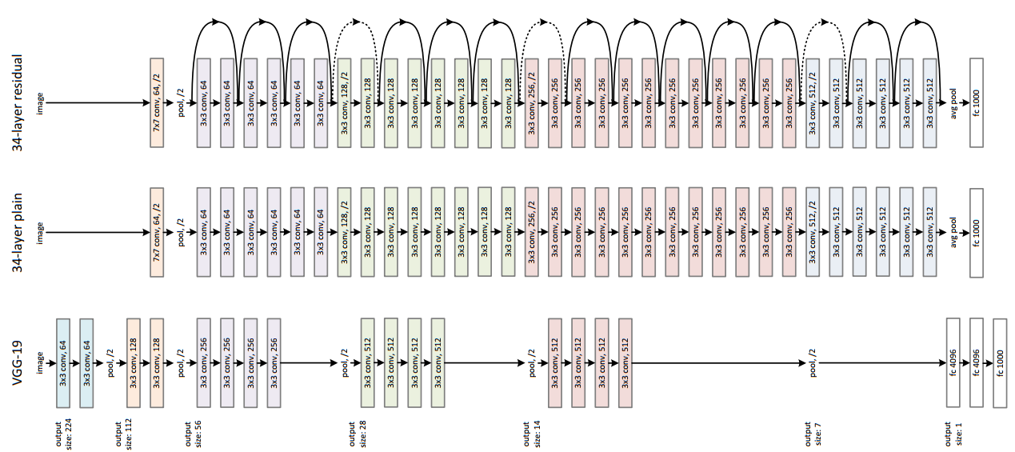
ResNet Actual Implementation

Slide 49
Why ResNet?
When the deeper network starts to converge, a degradation problem has been exposed: with the network depth increasing, accuracy gets saturated (which might be unsurprising) and then degrades rapidly
Such degradation is not caused by overfitting not by more layers
But because of the failure of the traditional optimization methods
Therefore, we add workarounds to propagate the information needed to optimize better
So, does ResNet solve the problem?
The next slide shows the improvements

Slide 50
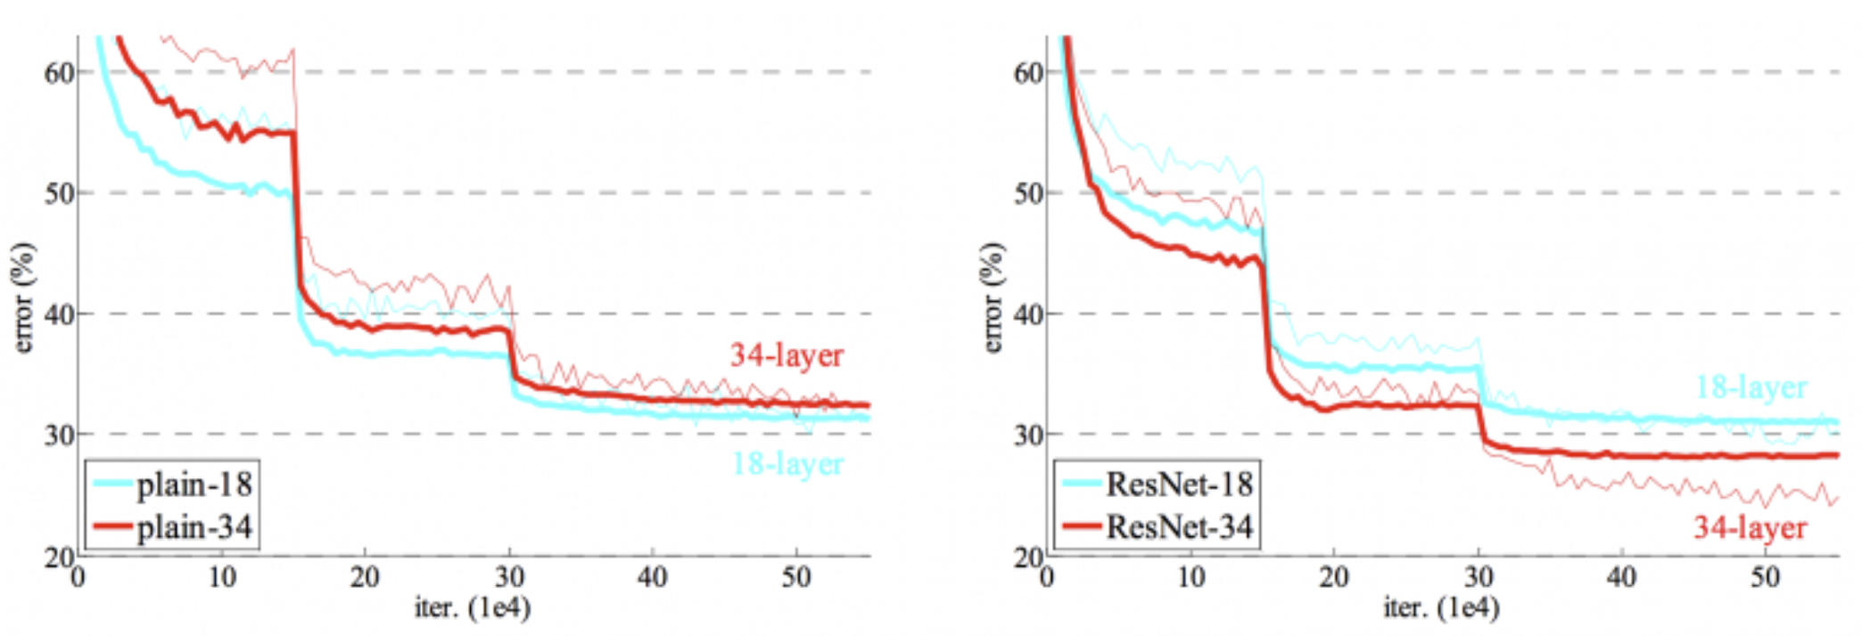
ResNet

Slide 51
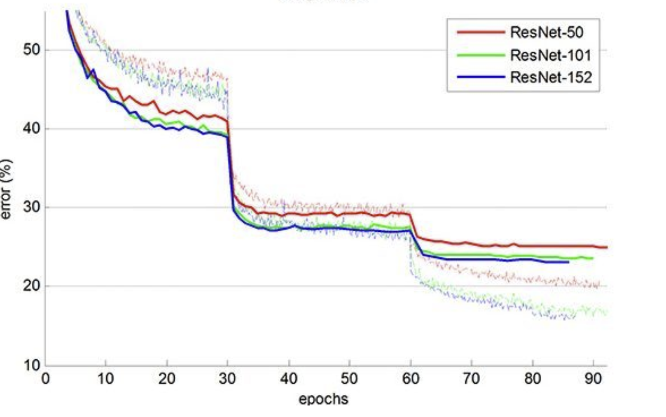
ResNet

Slide 52
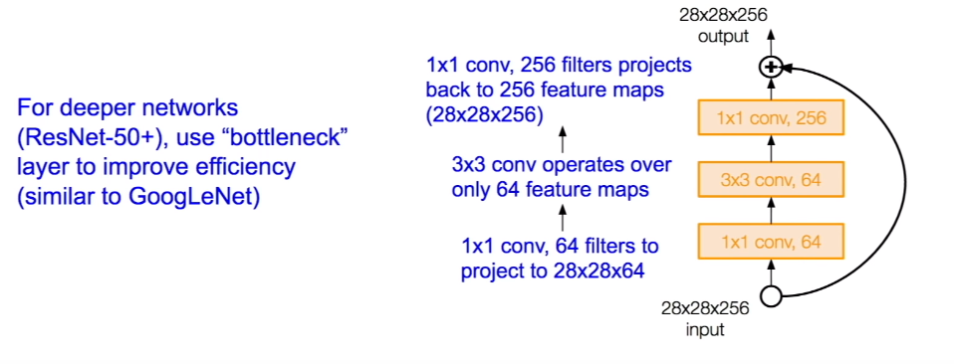
More optimizations

Slide 53
ResNet in practice
Batch normalization after every CONV layer
Xavier/2 initialization from He et al.
SGD + Momentum (0.9)
Learning rate: 0.1, divided by 10 when validation error plateaus
Mini-batch size 256
Weight decay of 1e-5
No dropout used

